Slide 1
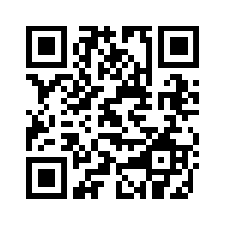



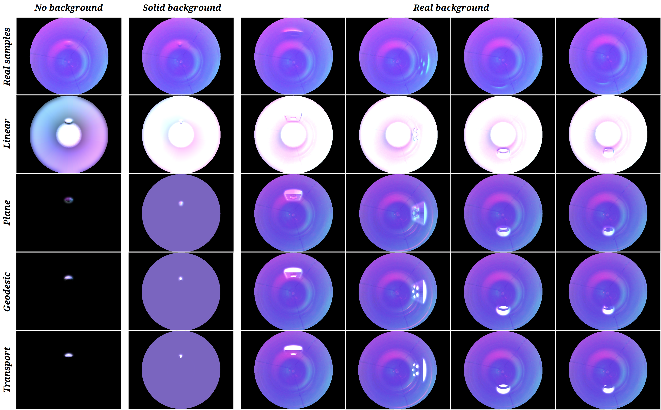
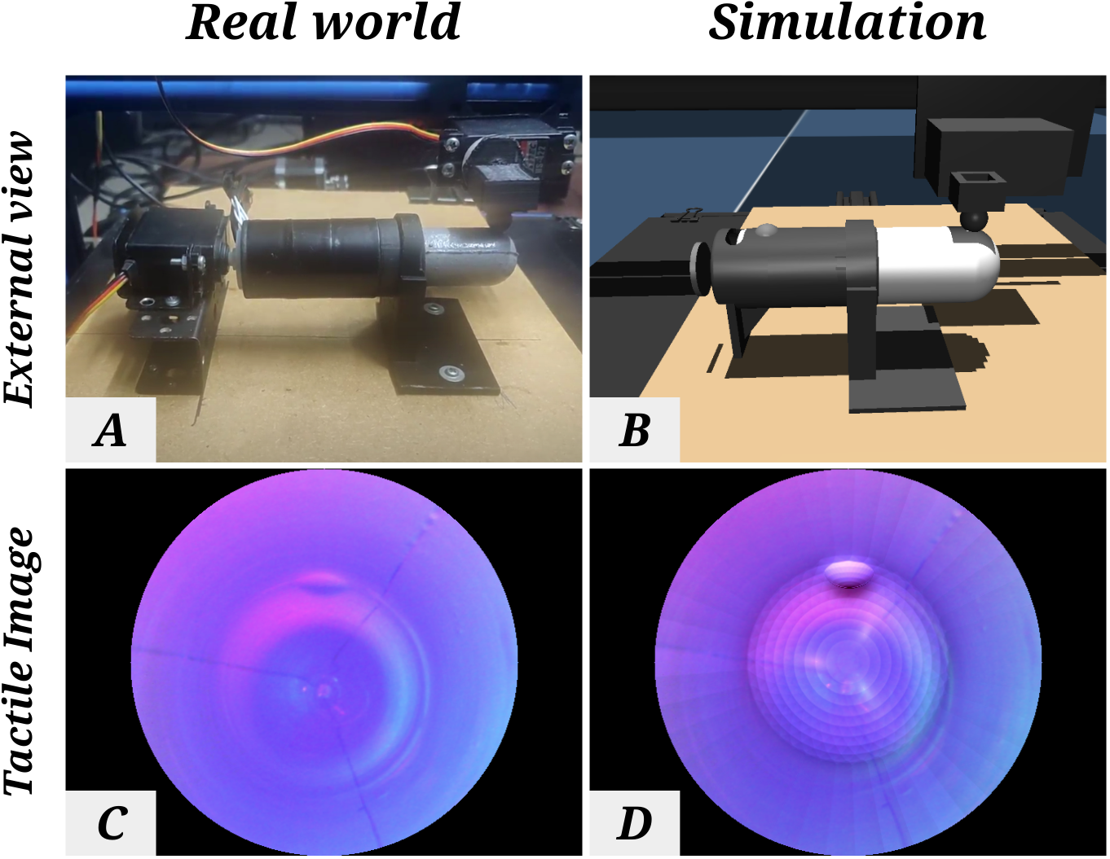
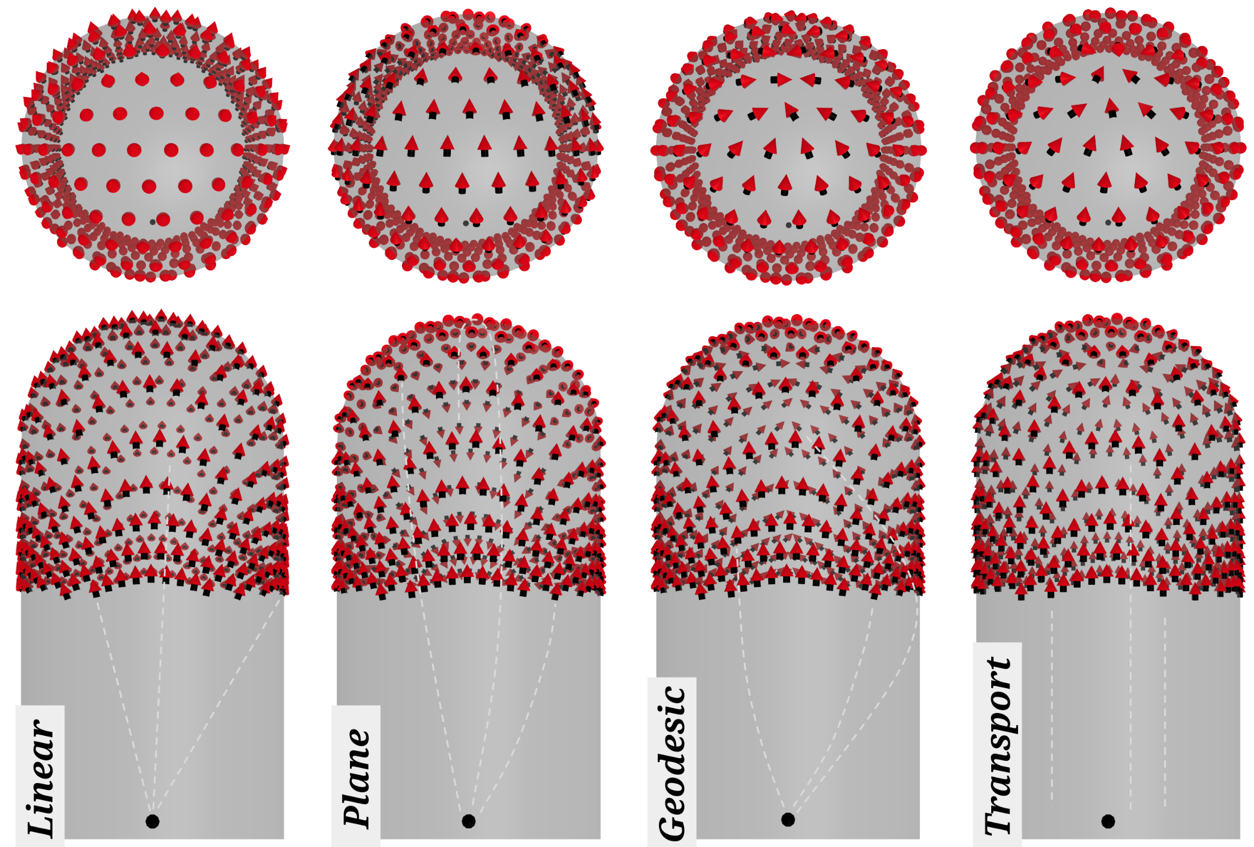
Beyond Flat GelSight Sensors: Simulation of Optical Tactile Sensors of Complex Morphologies for Sim2Real Learning
Daniel Fernandes Gomes^{1,2}, Paolo Paoletti³ and Shan Luo²
¹ Department of Computer Science, University of Liverpool ² Department of Engineering, King’s College London ³ School of Engineering, University of Liverpool {daniel.gomes, shan.luo}@kcl.ac.uk, paoletti@liverpool.ac.uk
Samples of tactile images from the real and synthetic datasets, using the four studied light fields: Linear, Plane, Geodesic and Transport.
Three scenarios are illustrated: None, solid and real image background illumination.
As shown, the three latter methods can successfully be combined with the real background image.
Abstract
Several morphologies have been proposed for the GelSight sensors. However, existing simulation methods are limited to flat surface designs [2]. We introduce a novel approach for simulating curved GelSight sensors such as the GelTip[3].
Light fields. The linear light field is highly non-tangent to the surface of the sensor around the tip, which results in the bright synthethic tactile images.
Experimental setup. The sensor is on real (A) and simulated (B) 3D printers, and corresponding tactile images (C, D).
Conclusions
A field composed of light vectors that are tangent to the sensor surface, enables the usage of the real image as background illumination, producing the the best results. Differences between tangent fields are challenging to assess quantitatvely due to small contact areas and small missalignment between contacts.
Future Work
We’ll use the model to aid the development of new sensor morphologies and to carry out experiments on robotic manipulation, in simulation.
References [ 1 ] D F Gomes, P Paoletti and S Luo, “Beyond Flat GelSight Sensors: Simulation of Optical Tactile Sensors of Complex Morphologies for Sim2Real Learning”, RSS 2023
[2] D F Gomes, P Paoletti and S Luo, “Generation of GelSight Tactile Images for Sim2Real Learning”, IEEE RA-Letters, April 2021
[3] D F Gomes, Z Lin and S Luo “GelTip: A finger-shaped optical tactile sensor for robotic manipulation”, IROS 2020

